Slide 1
OOP Concepts & SV Basics

Slide 2

OOP concepts
Inheritance
The procedure in which one class inherits the attributes and methods of another class (Parent class).
Notes:
Class defines attributes and methods.
An object is an instance of a class.

Slide 3
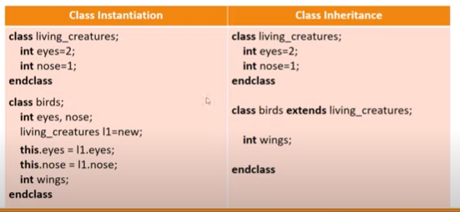
OOP concepts - Inheritance
Notes:
In class instantiation, the birds class variables have inherited the properties from the class living creatures.
Instead of doing the entire procedure of class instantiation to inherit, oops provides the keyword extends to inherit the properties. All variable values declared in living creatures is same for class birds.

Slide 4
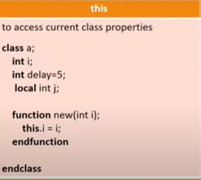
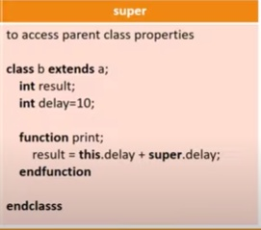
this, super & local (data hiding)
Notes:
In this, within the constructor function new, the variable int i is passed. This.i refers to the class i which is equal to the variable i passed in the function.
In class a, another integer delay=5 is declared. Class b extends from class a , and this has same variable delay which is initialized to 10. Inside the function print, delay of present class is added to delay of class a.
With extends keyword, in case you want to utilize some variable of class a that you don’t want to be part of child classes, it is declared with local. So class b that extends class a wont be able to access the integer j. This is called data hiding using local keyword.

Slide 5
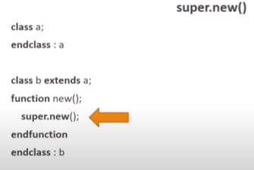

Chain Constructor
Notes:
Super.new() is the chain constructor function.
Whenever you call b = new(), it will call super.new(). Super is parent class property. So new function of class a will be called. And whatever is written into the new() function will be implented. OOPs however, supports only one level of inheritance. So super.super.new() can never be called.

Slide 6
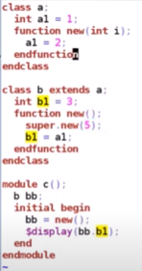
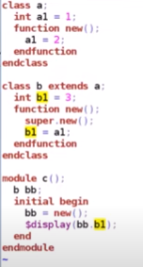
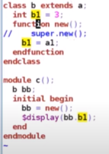
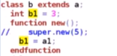
Chain Constructor
Notes:
Whenever you take bb = new (), the first statement that will get executed is that of parent class. So int a1 = 1 is executed first . Next, int b1 = 3. In new(), super.new() is called and new () of parent class is executed first. A1=2, Next, b1=a1 which is 2.
Even if super.new() is commented out, the result will still be bb = 2, since when the function new() is executed in class b, the first thing that gets executed by default is super.new(). The compiler automatically calls the super.new even if not specifically coded by user.
What if you pass a parameter int I into the class a function new(), and in super.new you pass an argument 5, and in class a new function, a1= i. The value will be displayed as 5
In this case if you comment out super.new(), the compiler will throw a compilation error because no argument is getting passed to satisfy the new function declared in class a. It is compulsory to call super.new.
Hence, super.new is not compulsory to be coded, unless some argument is getting passed, in which case its mandatory.

Slide 7
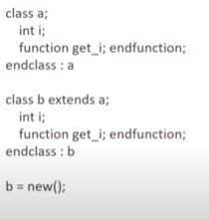
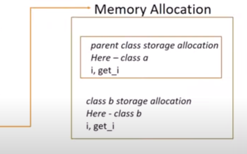
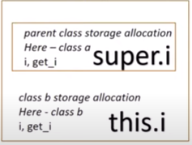
Inheritance Memory Allocation
Notes:
Instance of b is b itself. Inside the total memory, there is class b storage allocation. There is also the parent class allocation stored in the memory. So, when b = new() is done, it creates memory for itself as well as for the parent class.

Slide 8
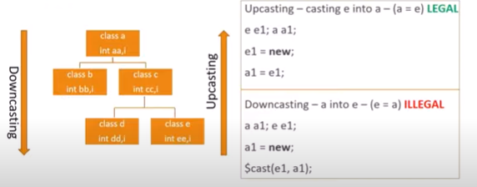
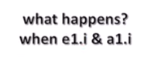
Overriden members – Upcasting & Downcasting
Notes:
For upcasting, you cast e into a which means a is equal to e. SV says this is legal. ….. As mentioned in the previous slide, whenever child class object is created, it stores in memory even the parent classes. Which means e stores c as well as a. When a1 = e1 is executed, a1 points to e1.. Meaning in the memory allocation of e, a1 points to its own property. Upcasting is assigning the derived class’s handle to the base class. The advantage is obvious .. Reuse.
When you call e1.i, it refers to the object of class e memory location . When you call a1.i, it refers to object of class a memory location. Suppose I value is different in both classes, the respective values will be reflected.
In downcasting, when you do a1 = new, memory is allocated only for class a and not for e. Which means e1.i is not in existence yet for its value to be known. So e1 = a1 is illegal. This calls for dynamic casting. In case you really want to use e1 = a1, $cast will cast a1 into e1, and then the memory location can be used. Downcasting is assigning the base class handle to the child class handle. But, this will not work until the base class handle already refers to child class handle. It is always illegal to directly assign a superclass variable to a variable of one of its subclasses. However, it is legal to assign a superclass handle to a subclass variable if the superclass handle refers to an object of the given subclass. $cast can be called as a task or a function. It is used to assign values to variables that might not ordinarily be valid because of differing data types.
Eg: typedef enum {red, green, blue, yellow, white, black} Colors; Colors col; $cast (col, 2+3)

Slide 9
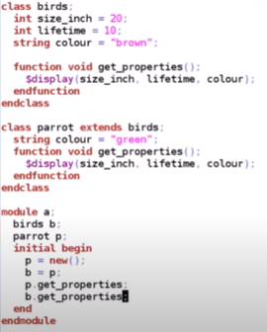
Upcasting

Slide 10
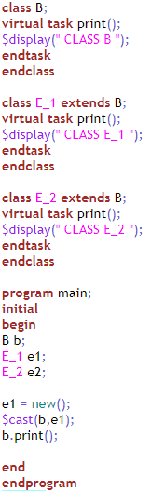
Notes:
In OOP, when a function (or task) is declared as "virtual" in a base class, it means that it can be overridden by derived classes.
$cast is used to dynamically cast one class type to another. The $cast function attempts to change the data type of a class handle.
$cast(<target_handle>, <source_handle>);
Result will be CLASS E_1

Slide 11
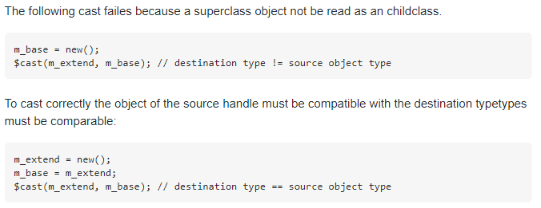
OOPS – Downcasting
$cast can be called as a function that will return a boolean indicating whether the cast was successful or not.
Eg: if ($cast(extended class_handle, base_class handle))

Slide 12
OOPS – Downcasting
class Parent;
int parent_var = 10;
endclass
class Child extends Parent;
int child_var = 20;
endclass
module tb;
Parent p;
Child c;
Child pc;
initial begin
c = new();
p = c; // This is a legal upcast. `p` is now referring to a `Child` object, but from the viewpoint of a `Parent`.
if ($cast(pc, p)) // Try to downcast `p` to `Child`
$display("Cast successful! pc.child_var = %0d", pc.child_var);
else
$display("Cast failed!");
end
endmodule

Slide 13
OOP concepts
Inheritance
Polymorphism
The procedure in which one class inherits the attributes and methods of another class (Parent class).
Ability of the object in belonging to different types with specific behavior of each type.

Slide 14
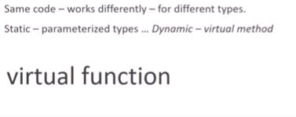

OOP concepts - Polymorphism
Notes:
We will see further on that in case of static polymorphism, it can be accessed with parameterized types. And for dynamic polymorphism, we will use virtual method, or virtual function. How is code reused when using polymorphism?

Slide 15
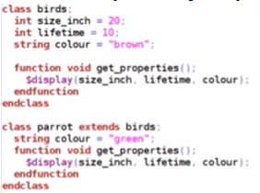
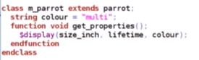
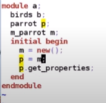
OOP concepts - Polymorphism
Notes:
In case of previous example, lets take a class for a multicolor parrot
When p.get_properties is done, the color displayed will be green. Since p refers to its own class, and not the class of m_parrot.
Now, in order to work with multi parrot class props, all functions will be declared as virtual
Last two lines of initial begin are replaced with b instead of p to go to the highest hierarchy.
The simulation result shows you were able to get multicolor just by using b.get_properties.
If you replace b. with p., the same simulation result appears. This happens since all functions are virtual, it ensures that even if you are calling p.get_properties, it will call the function of the last child level. So when you do p = m, even though it refers to its own property, since functions are virtual, it will display the function of the last child. And p.get_props will give the result of the m_parrot class.
In actual real-life code, there will be a lot of p.functions being called

Slide 16
OOP concepts
Inheritance
Polymorphism
Abstraction
The procedure in which one class inherits the attributes and methods of another class (Parent class).
Ability of the object in belonging to different types with specific behavior of each type.
Used to hide certain details and only show essential features of the object (deals with outside view of the object).
Notes:
Abstract classes are general classes and are used when gen/spec is included in the design. The general class becomes the abstract class. The abstract class has no direct objects or class instances, and is only used in conjunction with specialized classes. Abstract classes usually have attributes and may have a few methods.

Slide 17
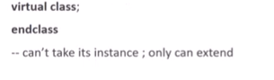
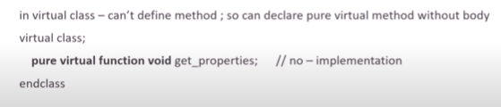
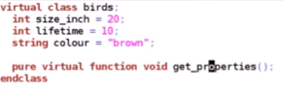
OOP concepts – Abstract class and pure virtual method
Notes:
When virtual keyword is used for class instead of functions within the class, it means that the instance of the class cannot be taken, it can only be extended.
If the parent class birds itself is declared as virtual, then compilation will throw an error.
The need for such virtual classes is that sometimes in verification, there will be the necessity that there will be some base test that configures parameters of DUT, but it is not possible to directly take instance of base test. So, to avoid any confusion, it is declared as virtual, meaning that the class can only be extended to add any extra props.
In a virtual class, functions will have to be declared as pure virtual function meaning that the function has no implementation. But, in the extended class, there can be an extension of the function.

Slide 18
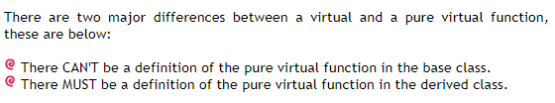
OOPS – Pure virtual function

Slide 19
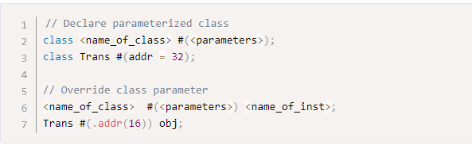
OOP concepts – Parameterization
Parameterization
Writing code that can be reused across wide range of applications.
Notes:
Why do we need parameterization for classes?
At times, it would be much easier to write a generic class that can be instantiated in multiple ways to achieve different array sizes or datatypes. This avoids the need to achieve different array sizes or data types. This avoids the need to rewrite code for specific features like size or type and instead allow a single specification to be used for different objects. This is achieved by extending the parameter mechanism to classes.
Parameters are like constants that are local to the specified class. Classes are allowed to have default value for each parameter that can be overridden during class instantiation.
Parameterized Classes - A Parameter is a kind of a constant that represents a value change or a data type. The compiler evaluates Parameter expression as part of its elaboration and code generation phases before the Simulation starts. So we can use the Parameter as part of the declaration of another type or use a Parameter value in lets say range of an array declaration. Note: We can not change a Parameter once a Simulation starts.
SystemVerilog uses a “#” sign to list the Parameter names in a Class Header to define a Generic Class. When we reference the Generic Class we also use the pound (#) sign to provide a list of Parameter Assignments or Overrides. When we specify a default Parameter in a Class Header, we don’t have to provide an Overrides for that Parameter when referencing that Class.

Slide 20
OOP concepts – Parameterization
Parameterization
Writing code that can be reused across wide range of applications.
Notes:
Classes:
Classes, by themselves, cannot be simulated directly.
They need to be instantiated within some procedural block (like initial or always) to be part of the simulation.
This instantiation is typically done inside modules, interfaces, programs, or other classes. Most commonly, class objects are created inside testbenches (which are often modules or programs) to represent entities like drivers, monitors, or stimuli generators.
Programs:
A program block is typically used for testbench code in SystemVerilog. It provides a place to instantiate and run sequences, create class objects, and interface with the DUT (Device Under Test).
Programs can be instantiated within a module, and this is a common practice for creating testbenches. A module might represent the top-level of a test environment, and within this module, one or more programs can be instantiated to represent specific parts of the testbench.
In the context of running a simulation, usually, a top-level module is what's directly instantiated and simulated. Within this top-level module:
Classes are instantiated to represent various testbench components or data structures.
Programs can be instantiated to organize the testbench or abstract certain operations.

Slide 21
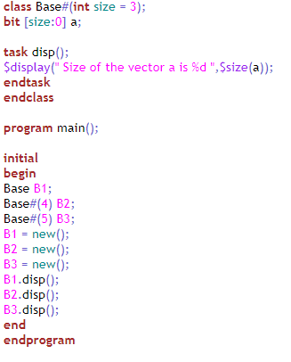
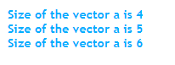
Notes:
Function:
A function is used to return a value.
It does not consume simulation time.
It's often used for computations that should be completed instantaneously in simulation time.
Cannot contain timing control statements like # (delay), @ (event trigger), or wait.
Task:
A task does not return a value (though it can modify its output arguments).
It can consume simulation time.
Suitable for operations that represent actual time-consuming activities in a simulation.
Can contain timing control statements

Slide 22
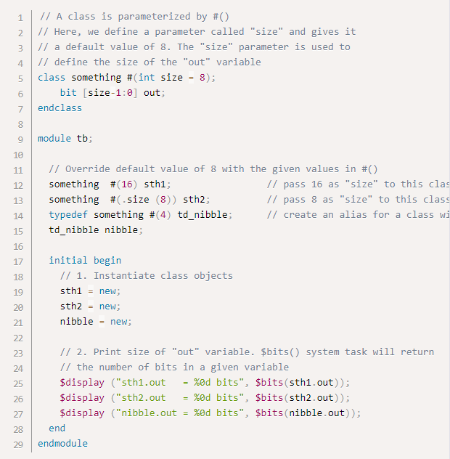
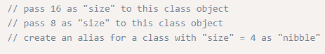
Notes:
The example here is a parameterized class that has size as the parameter that can be changed during instantiation.
The simulation result for display statements will give the following output
sth1.out = 16 bits
sth2.out = 8 bits
nibble.out = 4 bits

Slide 23
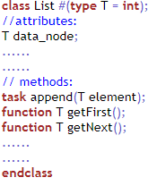
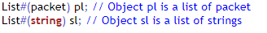
OOP concepts – Parameterization
Notes:
In this case, data-type is parameterized and can be overridden during instantiation. In the previous case, parameters were defined to have a specific value.
The class definition provides us with a template of an actual class.
In the example, suppose you want to define a list class which should be a generic type. Thus, it should be possible to declare list objects for integers, bits, objects, or any other type.
The class List is a template for various types. The identifier T is used as a placeholder for an actual type. For example, append takes one element as an argument. The type of this element will be the actual data type with which an actual list object is created.
For example, we can declare a list object for “packet” if a definition for the type “packet” exists. The line declares List#(packet) to be a list for packets. At this time, the compiler uses the template definition, substitutes every occurrence of T with packet and creates an actual class definition for it.

Slide 24
OOP concepts – Parameterization
If a class A is parameterized with a data type B, A is called template class. Once an object of A is created, B is replaced by an actual data type.
This allows the definition of an actual class based on the template specified for A and the actual data type.

Slide 25
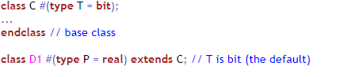

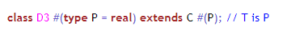
Extending Parameterized Class
Notes:
A parameterized class can extend another parameterized class.
Class D1 extends the base class C using the base class’s default type (bit) parameter.
Class D2 extends the base class C using an integer parameter.
Class D3 extends the base class C using the parameterized type (P) with which the extended class is parameterized.

Slide 26
OOP concepts – Encapsulation
Parameterization
Encapsulation
Writing code that can be reused across wide range of applications.
Separates an object’s state from its behavior. Helps in hiding an object’s data describing its state from further modification by external component.
Notes:
Encapsulation : In SystemVerilog there are three different terms used for hiding data constructs and these are public, private and protected . As we know an object can be associated with data with predefined classes and in any application an object can know about the data it needs to know about. So any unnecessary data are not required by an object can be hidden by this process. It can also be termed as information hiding that prohibits outsiders in seeing the inside of an object in which abstraction is implemented.

Slide 27
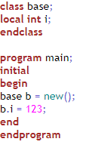

OOP concepts - Encapsulation
Notes:
A member identified as local is available only to methods inside the class. These local members are not visible within subclasses. However, nonlocal methods that access local class properties or methods can be inherited and work properly as methods of the subclass.
The above example will give compilation error.

Slide 28
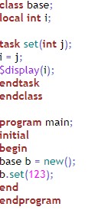
OOP concepts - Encapsulation
Notes:
The result will be 123.

Slide 29
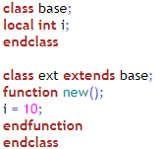

OOP concepts - Encapsulation

Slide 30
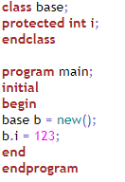
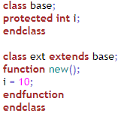
OOP concepts - Encapsulation
Notes:
A protected class property or method has all of the characteristics of a local member, except that it can be inherited; it is visible to subclasses.
Members declared as protected are accessible within the class where they are declared.
They are also accessible in subclasses derived from that class, regardless of whether the subclass is in the same package/module or a different one.
They are not accessible by any other code outside the class and its subclasses.

Slide 31
OOP concepts - Encapsulation
class Base;
int private_var = 0; // Private variable
protected int protected_var = 1; // Protected variable
// Public function to display variables
function void display();
$display("Base Class: private_var = %0d, protected_var = %0d", private_var, protected_var);
endfunction
endclass
class Derived extends Base;
// Function to modify protected_var from the subclass
function void modify_protected_var(int new_val);
protected_var = new_val; // Can access protected_var because Derived is a subclass of Base
endfunction
function void display();
$display("Derived Class: protected_var = %0d", protected_var);
endfunction
endclass

Slide 32
OOP concepts - Encapsulation
module test;
initial begin
Derived d = new();
d.display(); // Displays "Derived Class: protected_var = 1"
d.modify_protected_var(5);
d.display(); // Displays "Derived Class: protected_var = 5"
// Uncommenting the next line would result in a compilation error since protected_var is protected
// $display("%0d", d.protected_var);
end
endmodule

Slide 33
OOP concepts - Packages
Provide mechanism to store and share data, methods, property, parameters that can be re-used in multiple other modules, interfaces, or programs.
System Verilog provides package support to help share following:
Parameters
Data
Type
Task
Function
Sequence
Property
Few rules that should be followed with packages:
Packages cannot contain any assign statement.
Variable declaration assignments within the package shall occur before any initial, always (_ff, _comb, _latch).
Items within packages cannot have hierarchical references.
Assign statement on any net type is not allowed.
Notes:
A package groups a type declaration and a set of tasks or functions that operate on that type. Then, a module can declare objects of the type and use the package tasks/functions to operate on the object data.
A package is to define a utility for common use.
Point number 3 in rules:- items within packages cannot have hierarchical references except for those created within the package or made visible by the import of another package.

Slide 34
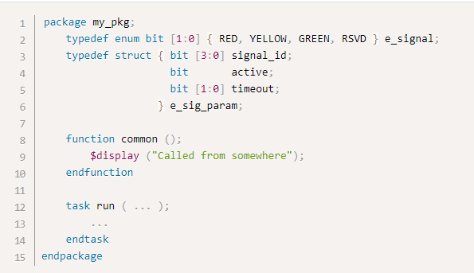
OOP concepts - Packages
Accessing data, functions or types in packages occur in two ways:
By class scope resolution operator ::
By import statement (the import statement provides direct visibility of identifiers within packages.

Slide 35
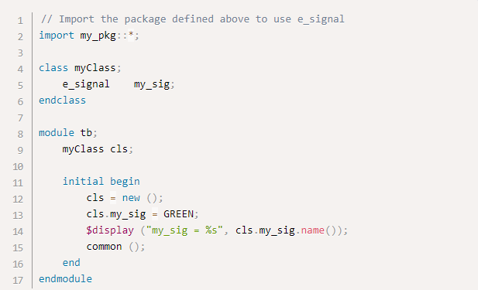
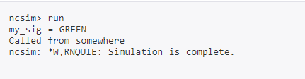
OOP concepts - Packages

Slide 36
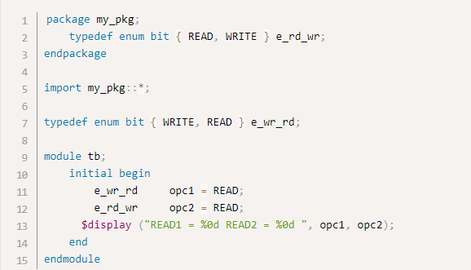
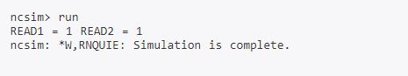
OOP concepts – Namespace collision
Notes:
The example has same definitions, one at the top level and the other via an imported package.
Even though my_pkg was imported, e_rd_wr variable opc2 got the value of READ as 1, which implies that the enum value inside the package is not considered.

Slide 37
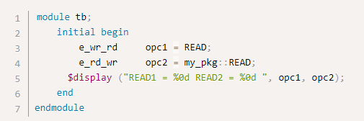
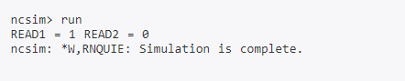
OOP concepts – Namespace collision
Notes:
In order for the simulator to apply value from the package, the package name should be explicitly mentioned using the :: operator.

Slide 38
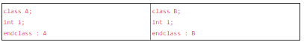
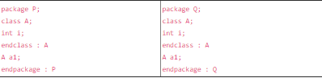
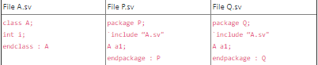
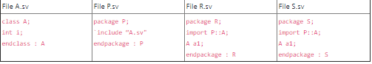
OOP concepts – package vs `include
Notes:
The first two class definitions will be unequal types because they have different names, even though their contents, or class bodies, are identical. The name of a class includes more than just the simple names A and B; the names also include the scope where the definition is declared. When you declare a class in a package, the package name becomes a prefix to the class name
Now there are two definitions of class A, one called P::A and the other called Q::A. And the variables P::a1 and Q::a1 are type incompatible referencing two different class A’s. Re-writing the above example using an include file creates the same situation – two incompatible class definitions.
After `including class A into each package, you wind up with two definitions of class A. Using `include is just a shortcut for cut and pasting text in a file. Importing a name from a package does not duplicate text; it makes that name visible from another package without copying the definition.
Class A is declared in package P, and only in package P. The variables R::a1 and S::a1 are type compatible because they are both of type P::A. The fact that class A was `included from another file once it is expanded is no longer relevant once you consider the placement of the text from the file.

Slide 39
OOP concepts – Class library
A class library is a pre-coded OOP template collection.
Class libraries enhance code reuse by providing implementations of repetitive jobs.
Notes:
Both network and desktop applications use class libraries.
Class libraries contain code for GUI elements such as buttons, icons, scroll bars, and windows, as well as other non-GUI components.
All OOP languages have class libraries.
Class libraries include all essential classes in a previously written coded format, which not only simplifies programming but only increases code quality.
Class template customization is implemented according to specific programming requirements.
Class libraries are continuously updated and time tested for reliability to reduce programming language limitations.
The UVM is a class library and methodology that takes full advantage of virtual classes, methods, and interfaces.
The UVM base class library is a set of template files that the user extends to build a UVM testbench and set of tests (transactions and sequences)

Slide 40
OOP concepts
Classes
Parameterization
Objects
Encapsulation
Inheritance
Packages
Polymorphism

Slide 41
SYSTEM VERILOG –
Basics

Slide 42
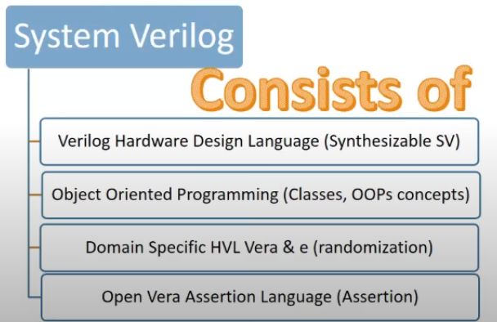
SV is a HDVL
System Verilog
Notes:
HDL like Verilog and VHDL are used to describe hardware behavior so that it can be converted into digital blocks made up of combinational gates and sequential elements. In order to verify that the hardware description in HDL is correct, there is a need for a language with more features in OOP that will support complicated testing procedures and is often called Hardware Verification language. SV is HDVL – hardware description & verification language.
SV is an extension of Verilog with many such verification features that allow engineers to verify the design using complex testbenches and random stimuli in simulation.
Why Verilog is not preferred? In 1990s, Verilog was the primary language to verify functionality of designs that were small, not very complex and had less features. As design complexity increases, so does the requirement of better tools to design and verify it. SV is far superior to Verilog because of its ability to perform constrained random stimuli, use OOP features in testbench construction, functional coverage, assertions among many others.
However, these days UVM is replacing SV based verification in industry. UVM = structured SV. Its like a wrapper over SV that helps in reusability of code for verification.

Slide 43

System Verilog

Slide 44

System Verilog

Slide 45

System Verilog

Slide 46

System Verilog

Slide 47

System Verilog

Slide 48

System Verilog

Slide 49

System Verilog

Slide 50

System Verilog

Slide 51

System Verilog

Slide 52

System Verilog

Slide 53

System Verilog

Slide 54

System Verilog

Slide 55

System Verilog

Slide 56

System Verilog

Slide 57

System Verilog

Slide 58

System Verilog

Slide 59

System Verilog

Slide 60

System Verilog

Slide 61

System Verilog

Slide 62

System Verilog

Slide 63

System Verilog

Slide 64

System Verilog

Slide 65

System Verilog

Slide 66

System Verilog

Slide 67

System Verilog

Slide 68

System Verilog

Slide 69

System Verilog
Notes:
Localparam is used to protect the value of the variable defined as localparam from accidental or incorrect redefinition by end-user (unlike a parameter value, this value can’t be modified by parameter redefinition or by a defparam statement).
Local parameters can be declared in a generate block, package, class body or compilation-unit scope.

Slide 70

System Verilog
Notes:
The behavior of a system is written as an assertion that must be true at all times.
This implies that assertions are used to validate the behavior of a system defined as properties, and can also be used in functional coverage.

Slide 71

System Verilog

Slide 72

System Verilog
Notes:
This is an example of an immediate assertion.

Slide 73


System Verilog – How to verify
Notes:
NOTE: The predefined gates in SV are and, nand, or, nor, xor, xnor. For these gates, port order is (output, input(s)).
For user-defined modules, port order is however you define it.

Slide 74

System Verilog Features

Slide 75

System Verilog – Data types
logic replaces reg of Verilog
logic can be net or reg depending on usage
Advantage of logic type: No need of port list rules

Slide 76

System Verilog – Data types
Notes:
If wire is declared as reg accidentally, the compilation will throw an error. In SV, logic is used and confusion with reg and wire is avoided.
If a =4, and b=1, then the value of z will be displayed 5 for all ports declared as logic.

Slide 77
System Verilog–Groups of Data Object
Net and variable – differ in the way in which they are assigned and hold values
NET
written by one or more continuous assignment
cannot be procedurally assigned
shall not store a value
VARIABLE
written by one or more procedural statements
written by one continuous assignment
stores and holds value; last write determines the value
Notes:
Net is basically an interconnection between two variables.
Continuous assignment means assign statement
Procedural assignment means within initial or always block

Slide 78


System Verilog - Net

Slide 79




System Verilog – Net (wire, tri, uwire, wor, trior, wand, triand)
For multiple drivers, truth table t1 (wire/tri), t2 (wand/triand), t3 (wor/trior)
Notes:
wire – one variable is assigned some value from another
For tri, en=1 will drive input to the output, but for en=0, regardless of whatever is the input value, the output will be high impedance.
when it says multiple drivers for tri, it means the input to the driver will have multiple drivers driving the input onto a single variable at the output. This will lead to some conflict at the input that needs to be resolved
The truth tables for multiple drivers resolves the output values for different combinations of input values.

Slide 80






Notes:
This is example code to display single driver (tri state).
The result will be a=1 and data=x if no delay is given for the display statement.
If a delay of #1 is given for all the initialization statements to execute before displaying values, the result will be a=1 and data =1.
If instead, s = 1’b0, the result will be a=1 and data=z

Slide 81

Notes:
This is the example for a multiple driver (tri state).
The result will be a=x and data=x. From truth table (for wire a), if one input is 0 and other input is 1, the output should be x. And for tri, s0 and s1 are both 1 -> bus0=1 and bus1=0, so from truth table, 1 and 0 will give output x.
If s0=1’b0 instead, then the result (based on truth table inputs z and 0 combination) will be a=x and data=0.

Slide 82

System Verilog–Data type classification
Notes:
Singular data type can be sliced into other sub-parts, they will be called singular only.
The need for classifying data types is so that singular data type can be treated as single vector.

Slide 83

System Verilog–Data type classification
Notes:
When you compile and run simulation, the display will show s=5. This implies that the variable value is assigned to struct_packed considering it as a single factor.
However, if you replace struct_packed with struct_unpacked for variable value assignment, the compilation will throw an error showing incompatible complex type, as unpacked type is not a single vector.
Similar concept used for memory allocation with data type classification. the allocation should happen side by side (not two locations wide apart) and the total memory for the variables of a packed structure will be considered as a single vector.

